Slide 1

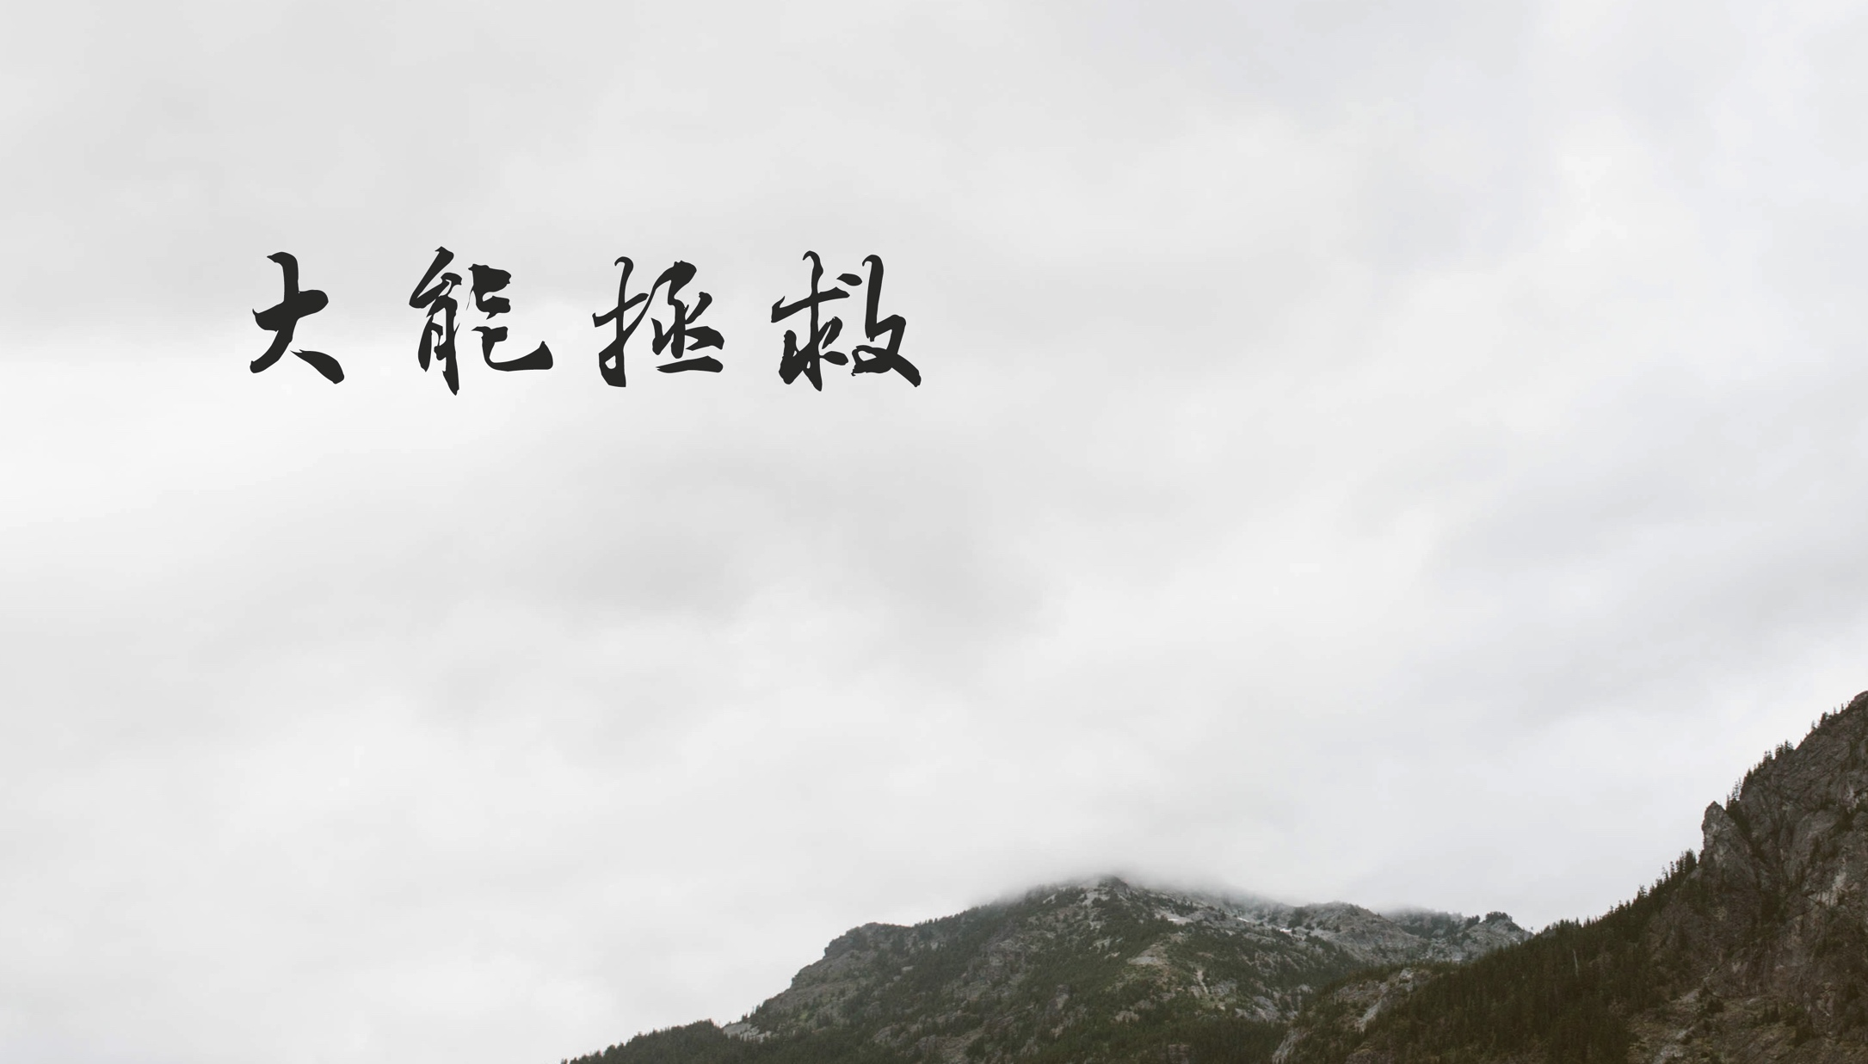
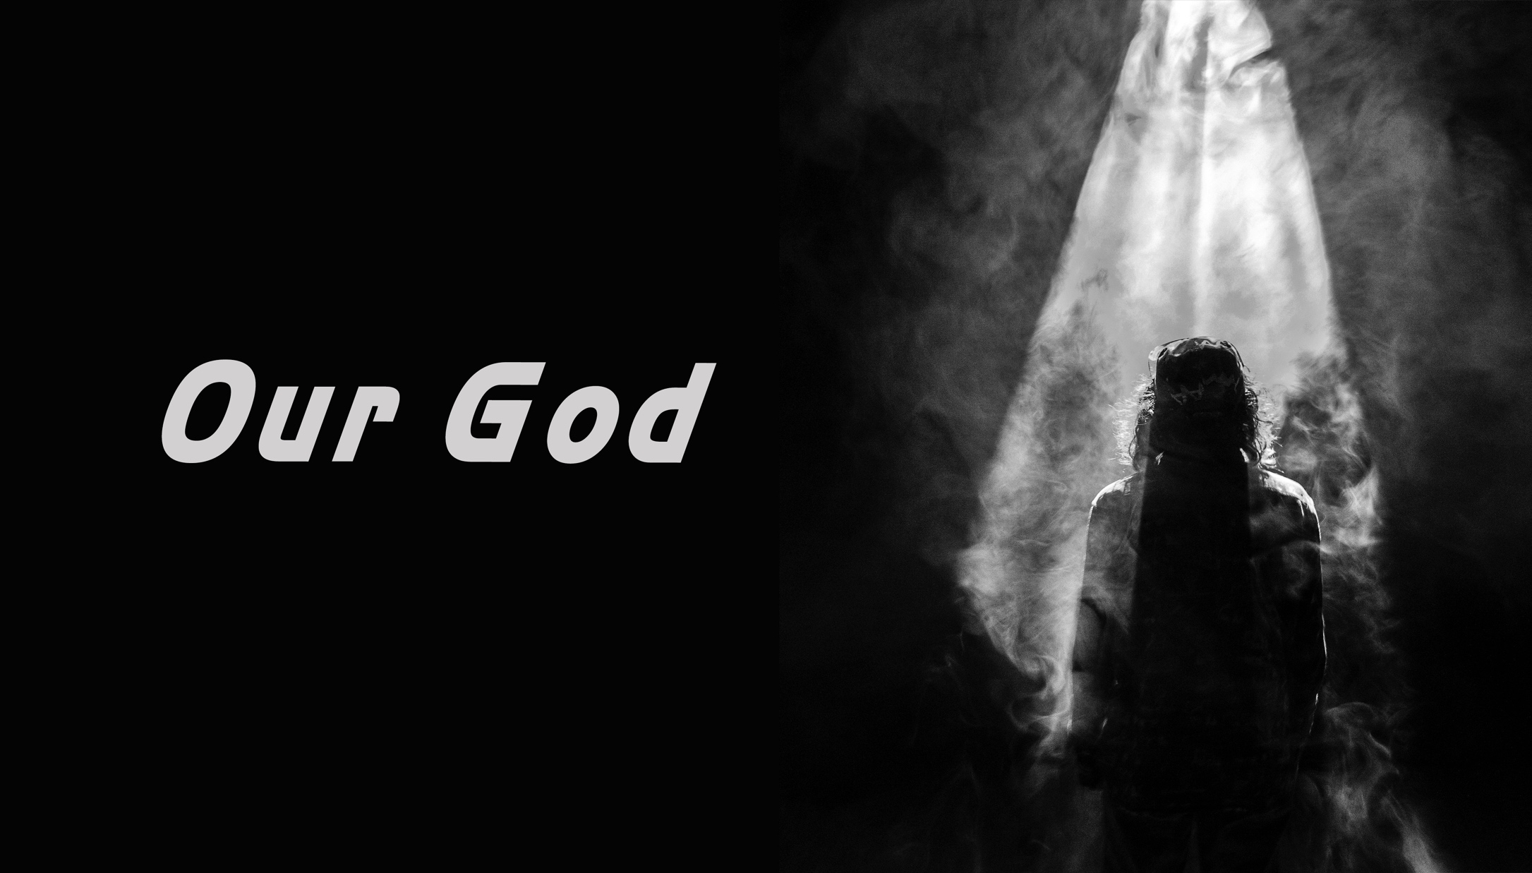

Slide 2

你将水变为美酒 使盲眼重见光明
Ni jiang shui bian wei mei jiu
Shi mang yan chong jian guang ming
Verse1-1

Slide 3
无人能像你 无人像你
Wu ren neng xiang ni Wu ren xiang ni
Verse1-2

Slide 4
你荣光驱走黑暗 赐华冠代替灰尘
Ni rong guang qu zou hei an Ci hua guan dai ti hui chen
Verse2-1

Slide 5
无人能像你 无人像你
Wu ren neng xiang ni Wu ren xiang ni
Verse2-2

Slide 6
我神最伟大 我神最刚强
远超过世上一切的君王
Wo shen zui wei da Wo shen zui gang qiang
Yuan chao guo shi shang yi qie de jun wang
Chorus-1

Slide 7
他医治我们 他满有权能
Our God Our God
Ta yi zhi wo men Ta man you quan neng
Our God Our God
Chorus-2

Slide 8
in 4

Slide 9
你荣光驱走黑暗 赐华冠代替灰尘
Ni rong guang qu zou hei an Ci hua guan dai ti hui chen
Verse2-1

Slide 10
无人能像你 无人像你
Wu ren neng xiang ni Wu ren xiang ni
Verse2-2

Slide 11
我神最伟大 我神最刚强
远超过世上一切的君王
Wo shen zui wei da Wo shen zui gang qiang
Yuan chao guo shi shang yi qie de jun wang
Chorus1-1

Slide 12
他医治我们 他满有权能
Our God Our God
Ta yi zhi wo men Ta man you quan neng
Our God Our God
Chorus1-2

Slide 13
我神最伟大 我神最刚强
远超过世上一切的君王
Wo shen zui wei da Wo shen zui gang qiang
Yuan chao guo shi shang yi qie de jun wang
Chorus2-1

Slide 14
他医治我们 他满有权能
Our God Our God
Ta yi zhi wo men Ta man you quan neng
Our God Our God
Chorus2-2

Slide 15
IN 8

Slide 16
若上帝帮助我们 有谁能拦阻我们
若上帝与我同行 谁还能敌挡我们
Ruo shang di bang zhu wo men You shei neng lan zu wo men
Ruo shang di yu wo tong xing Shei hai neng di dang wo men
Bridge-1

Slide 17
若上帝帮助我们 有谁能拦阻我们
若上帝与我同行 谁还能敌挡我们
Ruo shang di bang zhu wo men You shei neng lan zu wo men
Ruo shang di yu wo tong xing Shei hai neng di dang wo men
Bridge-2

Slide 18
我神最伟大 我神最刚强
远超过世上一切的君王
Wo shen zui wei da Wo shen zui gang qiang
Yuan chao guo shi shang yi qie de jun wang
Chorus1-1

Slide 19
他医治我们 他满有权能
Our God Our God
Ta yi zhi wo men Ta man you quan neng
Our God Our God
Chorus1-2

Slide 20
我神最伟大 我神最刚强
远超过世上一切的君王
Wo shen zui wei da Wo shen zui gang qiang
Yuan chao guo shi shang yi qie de jun wang
Chorus2-1

Slide 21
他医治我们 他满有权能
Our God Our God
Ta yi zhi wo men Ta man you quan neng
Our God Our God
Chorus2-2

Slide 22
若上帝帮助我们 有谁能拦阻我们
若上帝与我同行 谁还能敌挡我们
Ruo shang di bang zhu wo men You shei neng lan zu wo men
Ruo shang di yu wo tong xing Shei hai neng di dang wo men
Bridge-1

Slide 23
若上帝帮助我们 有谁能拦阻我们
若上帝与我同行 谁还能敌挡我们
Ruo shang di bang zhu wo men You shei neng lan zu wo men
Ruo shang di yu wo tong xing Shei hai neng di dang wo men
Bridge-2

Slide 26

人人都需要怜悯
永不止息的爱 愿慈爱临到我
ren ren dou xu yao lian min
yong bu zhi xi de ai yuan ci ai lin dao wo
Verse1-1

Slide 27
人人都需要宽恕
都需要救主恩慈 万民的盼望
ren ren dou xu yao kuan shu
dou xu yao jiu zhu en ci wan min de pan wang
Verse1-2

Slide 28
救主 荣耀永恒的父
我神有大能拯救 他有大能拯救
jiu zhu rong yao yong he de fu
wo shen you da neng zheng jiu
ta you da neng zheng jiu
Chorus-1

Slide 29
到永远 他是救恩主宰
他复活 战胜死亡 耶稣战胜死亡
dao yong yuan ta shi jiu en zhu zai
ta fu huo zhan sheng si wang
ye su zhan sheng si wang
Chorus-2

Slide 30
in 4

Slide 31
照我本相接纳我
除去恐惧软弱 圣灵充满我
zhao wo ben xiang jie na wo
chu qu kong ju ruan ruo sheng ling chong man wo
Verse2-1

Slide 32
我献一生来跟随
抛弃追求的一切 全降服于你
wo xian yi sheng lai gen sui
pao qi zhui qiu de yi qie quan xiang fu yu ni
Verse2-2

Slide 33
救主 荣耀永恒的父
我神有大能拯救 他有大能拯救
jiu zhu rong yao yong he de fu
wo shen you da neng zheng jiu
ta you da neng zheng jiu
Chorus-1

Slide 34
到永远 他是救恩主宰
他复活 战胜死亡 耶稣战胜死亡
dao yong yuan ta shi jiu en zhu zai
ta fu huo zhan sheng si wang
ye su zhan sheng si wang
Chorus-2

Slide 35
愿主发光 愿全地看见
我们唱 荣耀归与复活的君王 耶稣
(x2)
yuan zhu fa guang yuan quan di kan jian
wo men chang rong yao gui yu fu huo de jun wang ye su
Bridge*2

Slide 36
救主 荣耀永恒的父
我神有大能拯救 他有大能拯救
jiu zhu rong yao yong he de fu
wo shen you da neng zheng jiu
ta you da neng zheng jiu
Chorus-1

Slide 37
到永远 他是救恩主宰
他复活 战胜死亡 耶稣战胜死亡
dao yong yuan ta shi jiu en zhu zai
ta fu huo zhan sheng si wang
ye su zhan sheng si wang
Chorus-2

Slide 38
救主 荣耀永恒的父
我神有大能拯救 他有大能拯救
jiu zhu rong yao yong he de fu
wo shen you da neng zheng jiu
ta you da neng zheng jiu
Chorus-1

Slide 39
到永远 他是救恩主宰
他复活 战胜死亡 耶稣战胜死亡
dao yong yuan ta shi jiu en zhu zai
ta fu huo zhan sheng si wang
ye su zhan sheng si wang
Chorus-2

Slide 42

The heavens declare The glory of God
And all of the world Will join the praise
His wonders proclaim
天堂的宣告 上帝的荣耀
万国万民 都将加入这场盛赞
Verse1

Slide 43
The oceans and skies, Lift up their voice
And all He has made, Will rise to bless
The King of all kings
海洋和天空 赞美之声撼天动地
祂所做的一切 将升为祝福 万王之王
Verse2

Slide 44
Let us adore Him Let us adore Him
Jesus Christ is the Lord
我们一起来敬拜祂
耶稣 基督 祂是主
Chorus1

Slide 45
Eternity’s King Is coming again
Though all of the earth Will fade away
His truth will remain
不朽的王者 将再次降临
即便万物 将会逝去 祂的信永存
Verse3

Slide 46
Let us adore Him Let us adore Him
Jesus Christ is the Lord
我们一起来敬拜祂
耶稣 基督 祂是主
Chorus1

Slide 47
Come and behold Him Bow down before Him
Jesus Christ is the Lord
来仰望祂 来向祂屈膝
耶稣基督 祂是主
Chorus2

Slide 48
in(8)

Slide 49
Hallelujah Hallelujah
You are worthy of all praise
哈利路亚 哈利路亚
祢是配得 所有赞美
Bridge-1

Slide 50
Hallelujah Hallelujah
You are worthy of all praise
哈利路亚 哈利路亚
祢是配得 所有赞美
Bridge-2

Slide 51
Let us adore Him Let us adore Him
Jesus Christ is the Lord
我们一起来敬拜祂
耶稣 基督 祂是主
Chorus1

Slide 52
Come and behold Him Bow down before Him
Jesus Christ is the Lord
来仰望祂 来向祂屈膝
耶稣基督 祂是主
Chorus2

Slide 53
Let us adore Him Let us adore Him
Jesus Christ is the Lord
我们一起来敬拜祂
耶稣 基督 祂是主
Chorus1

Slide 54
Come and behold Him Bow down before Him
Jesus Christ is the Lord
来仰望祂 来向祂屈膝
耶稣基督 祂是主
Chorus2

Slide 56


Slide 57

Grander earth has quaked before
Moved by the sound of His voice
广袤的大地曾因他的教诲
而微微颤动
verse1-1

Slide 58
Seas that are shaken and stirred
Can be calmed and broken for my re-gard
海洋中波涛翻腾激荡
因我的祷告而平静如初
Verse1-2

Slide 59
Through it all, through it all,My eyes are on you
Through it all, through it all,It is well
一路走来 披荆斩棘 我与你同行
历经磨难 重见光明 一切安好如初
Chorus

Slide 60
Far be it from me to not believe
Even when my eyes can't see
我是虔诚的信徒
即便我目不能视
verse2-1

Slide 61
And this mountain that's in front of me
Will be thrown into the midst of the sea
我眼前的万山阻隔
也会移到海中央最终消逝不见
verse2-2

Slide 62
Through it all, through it all,My eyes are on you
Through it all, through it all,It is well, It is well
一路走来 披荆斩棘 我与你同行
历经磨难 重见光明 一切安好如初
Chorus

Slide 63
So let go my soul and trust in Him
The waves and wind still know His name
(*3)
我主我愿为之舍弃灵魂信任你
风和浪传颂着他的英名
Bridge*3

Slide 64
It is well with my soul,It is well with my soul
It is well with my soul,It is well it is well with my soul
我的灵魂安好
我的灵魂安好
PC1-1

Slide 65
It is well it is well with my soul
It is well it is well with my soul
我的灵魂安好
我的灵魂安好
PC2-2

Slide 66
It is well with my soul,It is well with my soul
It is well with my soul,It is well it is well with my soul
我的灵魂安好
我的灵魂安好
PC2-1

Slide 67
It is well it is well with my soul
It is well it is well with my soul
我的灵魂安好
我的灵魂安好
PC2-2

Slide 68
It is well with my soul,It is well with my soul
It is well with my soul,It is well it is well with my soul
我的灵魂安好
我的灵魂安好
PC3-1

Slide 69
It is well it is well with my soul
It is well it is well with my soul
我的灵魂安好
我的灵魂安好
PC3-2

Slide 70
In 4

Slide 71
Through it all, through it all,My eyes are on you
Through it all, through it all,It is well, It is well
一路走来 披荆斩棘 我与你同行
历经磨难 重见光明 一切安好如初
Chorus

